Slide 1
man(ual) Pages
Extensive documentation that comes preinstalled with almost all substantial Unix and Unix-like operating systems
Usage
read a manual page for a Unix/Linux command
man <command_name>
man section command_name
Hit “q” to get out of man page.

Slide 2
man Page Sections
man <command>
First Line: command (number)
Shows what section of the man page you are viewing
Man page sections are: (man man) (1) User Commands (2) System Calls (3) Library functions (4) Devices (5) File formats (6) Games and Amusements (7) Conventions and Miscellany (8) System Administration and Privileged Commands
Notes:
Read is both a command and a system call

Slide 3
Reading man Pages
Standard Headings
Name: name of the command followed by a short description of what the command does
usually one sentence or less
Synopsis: describes how the command is supposed to be used. Example: ls [Option]…[File]…
Description: gives a more detailed definition of the command and provides the OPTIONs available for the command.

Slide 4
Reading man Pages
Other Common Headings
AUTHORS: the people who created or assisted in the creation of the command.
BUGS: lists any known defects or shortcoming of the programs.
EXAMPLES or NOTES: An illustration of how to use the command including general notes.
REPORTING BUGS: where you should report problems you’re having with the command.
COPYRIGHT: The person or organization that holds the copyright to this information; usually a disclaimer that this is free software.
SEE ALSO: Other commands that are related to this command. This section also frequently mentions any other documentation related to this command.

Slide 5
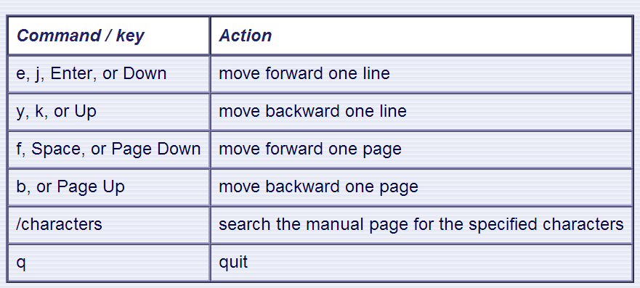
man – Moving Around
Use the following keys and commands to move around in the manual page:

Slide 6
wh… Commands
whereis <command>: locates the binary, source, and manual page files for a command
whatis <command>: returns Name section of man page
Can whereis be used to locate user files?

Slide 7
finding Files
-type: type of a file (e.g: directory, symbolic link)
-perm: permission of a file
-name: name of a file
-user: owner of a file
-maxdepth: how many levels to search

Slide 8
File Name Matching
?: matches any single character in a filename
*: matches one or more characters in a filename
[]: matches any one of the characters between the brackets. Use ‘-’ to separate a range of consecutive characters.

Slide 9
find Examples
Examples
find . -name my*
find . -name my* -type f
find / -type f -name myfile
find / -type d –name [xyz]
find / -type d –name [x-z]

Slide 10
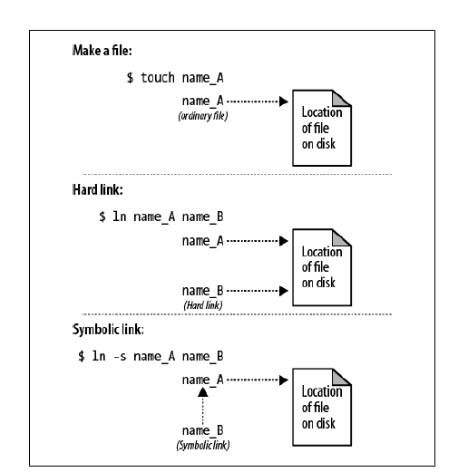
Symbolic Links vs. Hard Links
readlink command

Slide 11
Special Permissions
sticky bit (o+t)
On shared directories, it locks files within the directory from being modified/deleted by users other than the file creator, owner of the directory, or root, even if others have write permissions (Example: /tmp)
setuid, setgid (u+s, g+s)
On executables, it grants access to the process that runs this file based on the owner/group of the file, rather than the user running the executable file

Slide 12
Process: ps and kill
Process
An instance of a computer program in execution
ps
List processes that are currently running
kill
Terminate a certain process
Usage
kill PID

Slide 13
Daemon
A process that runs in the background
Example: cron
Enables users to schedule jobs to run periodically at certain times (cron jobs)
Usage: Full Backup every month

Slide 14
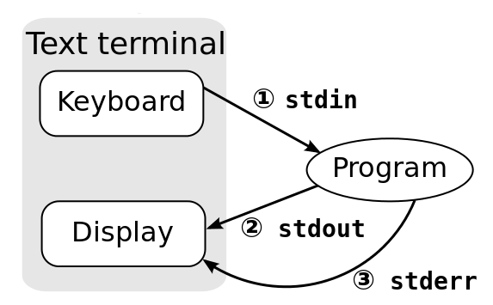
Standard Streams
Every program has these 3 streams to interact with the world
stdin (0): contains data going into a program
stdout (1): where a program writes its output data
stderr (2): where a program writes its error msgs

Slide 15
Redirection and Pipelines
program < file redirects file to programs’s stdin:
cat <file
program > file redirects program's stdout to file2:
cat <file >file2
program 2> file redirects program's stderr to file2:
cat <file 2>file2
program >> file appends program’s stdout to file
program1 | program2 assigns stdout of program1 as the stdin of program2; text 'flows' through the pipeline
cat <file | sort >file2
Notes:
15

Slide 16
Text Processing Tools
wc: outputs a one-line report of lines, words, and bytes
head: extract top of files
tail: extracts bottom of files

Slide 17
Locale
A locale
Set of parameters that define a user’s cultural preferences
Language
Country
Other area-specific things
locale command
prints information about the current locale environment to standard output
Notes:
17

Slide 18
diff
A file comparison utility that outputs the differences between two files.
Shows the changes between one version of a file and a former version of the same file
Usage
diff original_file new_file
diff –u original_file new_file

Slide 19
wget
A computer program that retrieves content from web servers
Usage
wget <URL>

Slide 20
Emacs
“The customizable, extensible, self documenting, real-time display editor”
Customizable (no programming)
Users can customize font, colors, etc. in ~/.emacs
Extensible (programming required)
Run Lisp scripts to define new commands (dired)
Self-documenting
C-h r (manual) and C-h t (tutorial)
Real-time
Edits are displayed onscreen as they occur

Slide 21
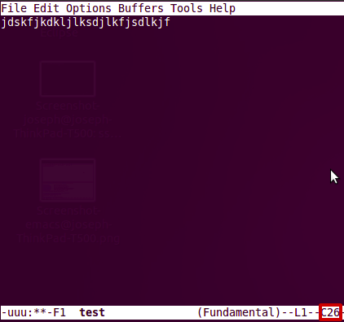
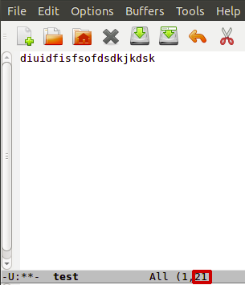
Getting Started
Install emacs
sudo apt-get install emacs
Emacs has both GUI and CLI
All emacs commands start with “C” or “M”
“C” = ctrl
“M” = Esc (Linux) / alt (Windows) / option (OS X)
Starting emacs
emacs <filename>
Exiting emacs
C-x C-c

Slide 22
Basic Editing
Insert text by simply typing it
Undo by typing C-x u
Save changes by typing C-x C-s
Copy, cut, paste
M-w (copy), C-w (kill), C-y (yank)
Command repetition
M-# <command> (M-2 C-n or M-5 C-f)

Slide 23
Dired (C-x d)
Creates an Emacs buffer containing list of dir
Allows you to navigate filesystem
Switch to different directories and list content
Allows you to operate on files
remove, rename, encrypt, decrypt, edit

Slide 24
Other Emacs Tricks…
Emacs as shell
Run shell commands
M-! <command>, M-x shell (interactive shell)
Emacs as IDE
Compile programs
M-x compile, then specify command to compile
Tip for homework: gcc hello.c –o hello
Run the executable by running the shell command
./hello

Slide 25
Submission Rules – Column Number Check
Emacs editor
M-x column-number-mode or
Options → Show/Hide → Check “Column Numbers”
The number inside the box is the Column Number.

Slide 26
80-Column Restriction in emacs
Add the following line to ~/.emacs
(setq-default fill-column 80)
Open your text file
Turn on AutoFill mode
“M-x auto-fill-mode” or
press “M-q” to auto wrap each paragraph

Slide 27
Carriage Returns
In Linux, line endings are represented by a line feed character
\n
In Windows, line endings are represented by a carriage return, followed by a line feed
\r\n

